Slide 1


PLEDGE TO PROGRESS Sustainability Hackathon
Sponsored By
Your Team Name : WeMeanSustainability
Your team bio : CG Sustainability SMEs, Architects and Developers
Fintech for Environmental Risk Assessment
Date : 24/04/2023

Slide 2




Problem Statement?
How does environmental risk impact financials of the firm?
Why did you decide to solve this Problem statement?
Scenarios Aligned:
Financial Services Industry (FSI)
Improve reporting capabilities Innovate to build GREEN financial tools, products, reporting capabilities to create relevant sustainability solutions & enhance customer engagement
Manage and monitor climate data to uncover risk
The environmental changes in the surroundings are inescapable, and growing variability in them poses risk that companies are unprepared for.
Growing number of environmental risk (Such as droughts, floods, extreme temperatures and violent storms) impacting financial of the firms, the global costs that approach $500 billion per year.
Currently many companies have no idea of what their exposure might be and how much additional spending is required to deal with it.
Industry Agnostic Scenario
Analysis, Prediction and forecasting capabilities using Azure Data, Analytics and AI capabilities
Proposed solution will help companies to identify the financial impact of such risk, will help to build resilience against unforeseen risk.
Notes:
Experts hope that by articulating the water risk in financial terms businesses may feel better equipped to address it.
Pepsi and Coca cola faced penalty of 25 crore for illegal over extraction of ground water
Sea level rise →habitat loss for few fishes → 17 and 34% habitat loss → 1.5 to 14 billion loss/year
Weather change → rising temperature → shorter winters → loss on skiing industry In US, about 1 billion loss in 12.2 billion ski and snowball industry

Slide 3
User Segment & Pain Points
Which user /advertiser segment would be early adopter of your product & why?
The solution provided by our tool will be beneficial to following entities:
Industries like beverages, energy and utility are highly prone to environmental issues
Industries like Agriculture and Construction Material which are highly dependent on natural capital
Financial Institutions/ Investors who have allocated large amount of funds in manufacturing industry
Financial institutions like Insurance and Investment Banking can identify risk proof investments
The tool proposes to address the gap in available risk assessment solutions, to also understand the financial impact of the risks and thereby assist in making more informed decisions.

Slide 4
Pre-Requisite
What are the alternatives/competitive products for the problem you are solving?
Tools | ESG Geo-Analyzer, ICE | Climate IQ, KPMG | Climate Excellence, PWC | Portfolio Analytics, Persefoni
About | Analyse climate and social features surrounding any specific location within US | Multi-industry risk management tool, running multiple scenarios to understand company’s exposure to climate change | Helps identify climate change opportunities and risks in the portfolios and impact at various levels | Provide carbon insights for decision making
Key features | Location specific customizable inputs Portfolio-level (or pool-level) risQ scores Self-service user interface | Assess exposure to physical risks of climate hazards The economic impacts of the transition to a low-carbon state | Visualize climate impact on revenue and profit Analysis beyond CO₂ price Scenario Analysis for transition and physical risks | Dashboard to visualize the potential carbon insights Allows user to model companies’ revenue against risk
Area of Services | Physical climate risk, social impact investing, and geospatial modelling | Digital climate scenario analysis | Climate scenario analysis software | Portfolio Analysis, Value at risk from transition, decarbonization pathways
Point of Parity with proposed tool | climate risk and demographic metrics at property level | Assessing Climate change impacts only | Assessing only Climate as indicator and impact on revenue and profit | Impact of climate change transition risk across portfolios
Point of Difference with proposed tool | Along with physical risk it will also identify financial impact | Apart from Climate scenario Other Environmental risk indicators are assessed E.g. Climate Change, Energy and Forest | Assesses not only Climate but also water, forest, and energy indicators and their financial impact | Specific to not only financial sector but caters to more industries
Notes:
Water risk assessment tools: WRI, WWF, CII Triveni, Sphera
Publications: Alliance for water stewardship, CEO Water mandate

Slide 5
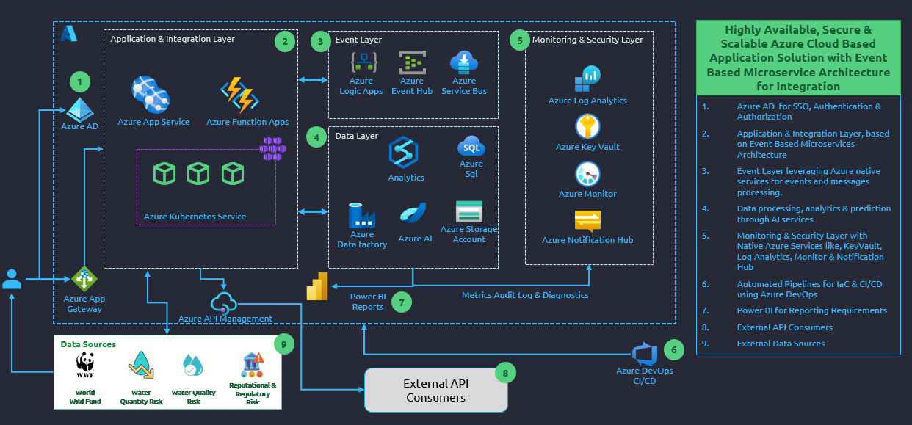
Tools or resources
Azure tools or resources which are likely to be used by you for the prototype, if your idea gets selected
Compute
App Services, Azure Functions, AKS
Data
Azure Data Factory, Storage Accounts, Azure Analytics, AI
Event Services
Service Bus, Event Hub, Logic Apps
Monitoring & Security
Azure App Insights, Key Vault, Private Endpoints, Azure AD, Notifications & Alerts
Automation
Azure DevOps – Pipelines, Dashboards
Automated deployments – Azure DevOps
Cost optimized – Autoscaling, Standard & Premium tiers
Sustainable – Optimized compute, auto shutdown & scale down/in rules

Slide 6
Any Supporting Functional Documents
Present your solution, talk about methodology, architecture & scalability
Methodology:
Risk Assessment has been conducted with the help of WWF’s Water Risk Filter to assess water risk and its impact on the financial performance using econometric equations.
The following block diagram depicts the logical flow to understand financial impact of water risks in particular location or list of locations. The proposed tool shall have capabilities to identify financial impacts for Climate, Water, Forest and Energy risks.
WWF’s Water Risk Filter providing Risk Scores for Water Scarcity, Flood Risk, Quality Risk, etc.
Probability of risk occurrence
Water Usage and cost at each location
Dashboard
List of locations with highest financial impact
Total Financial impact
Inputs for CDP responses on risk exposure
Inputs related to Industry Type, Locations and Importance of water for operation
Econometric equation to calculate financial impact of environmental risks

Slide 7
Key Differentiators & Adoption Plan
How is your solution better than alternatives and how do you plan to build adoption?
Differentiator:
Impact assessment of various environmental risks such as climate, water, forest and energy on financials using economentric modelling across industries.
The solution will guide users to identify highly impacted areas and help in defining where actions need to be taken to mitigate the risks.
Adoption Plan:
Building econometric model for Climate, Water, Energy and Forest related risks
Plan to run a pilot on existing clients of Capgemini
Intent to structure dynamic architecture to cater various industries’ need
Dashboard customization basis industry requirement
While we have currently envisaged this tool as a standalone solution, there’s scope to build this as an extension / custom module in Microsoft Sustainability Manager.

Slide 8
GitHub Repository Link & supporting diagrams, screenshots, if any
How far it can go?
Water risk assessment and assessing financial impact of the same
Similarly assessing Climate, Energy and Forest risks and corresponding financial impact
Assisting in providing reporting ready inputs E.g. CDP, TCFD, TNFD
Assisting in futureproofing business from environmental risks
Assisting in investment decisions for the leadership, asset managers, facility managers, etc.

Slide 9
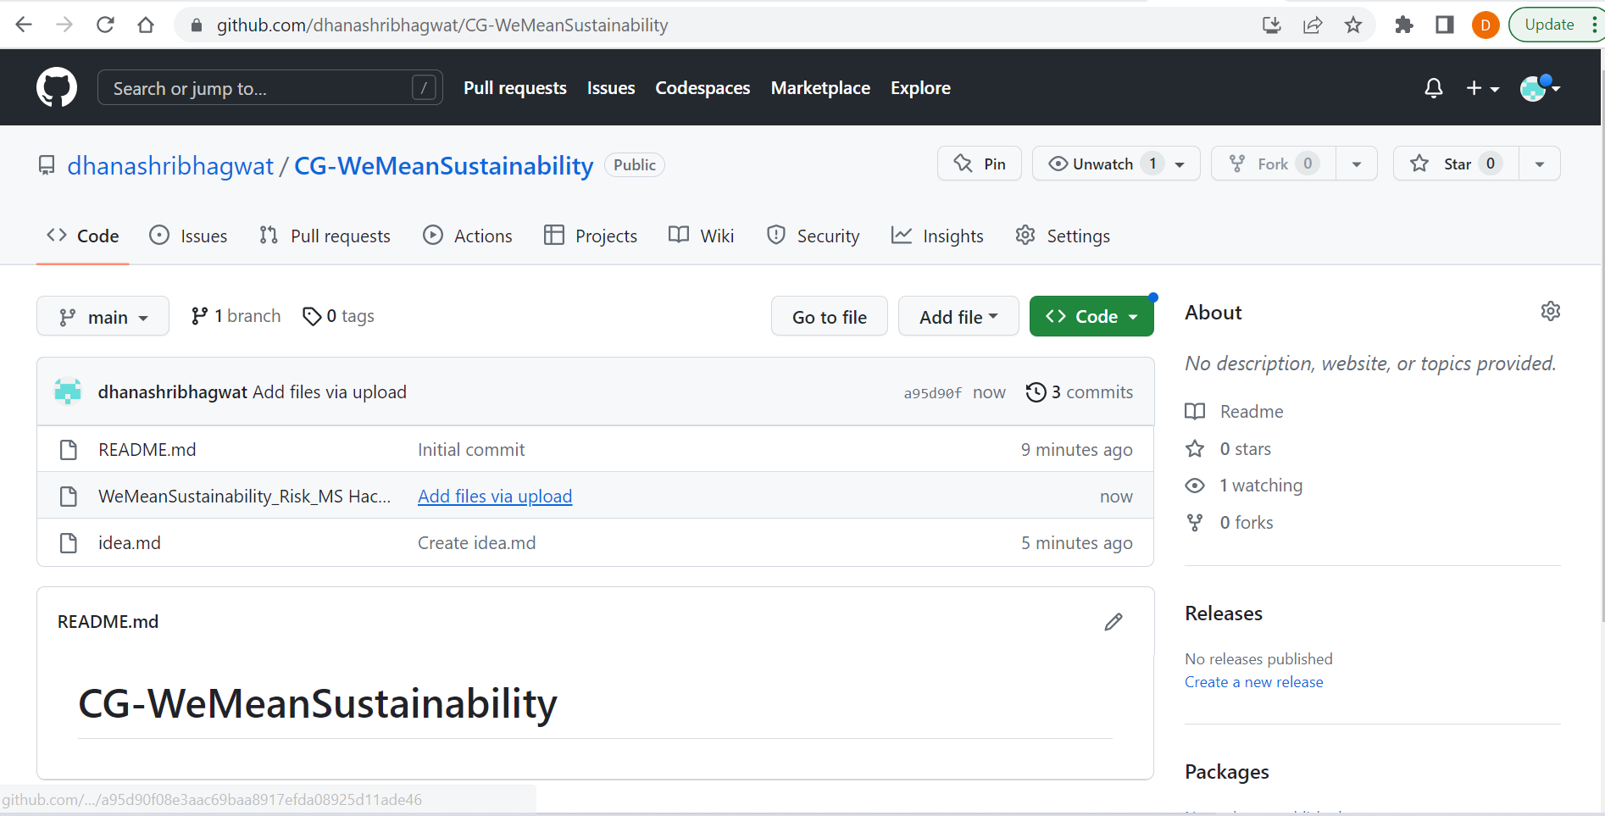
GitHub Repository Link & supporting diagrams, screenshots, if any
GitHub Repository Link: https://github.com/dhanashribhagwat/CG-WeMeanSustainability.git
Supporting diagrams shall be added in the next phase of development.

Slide 10
Thank You
Team member names:
Rajeshri Parmar
Kamlesh Bambarde
Abhishek Satish Dasari
Shubham Verma
Dhanashri Bhagwat

